Slide 1



Dual Enrollment at UWF
uwf.edu/DE | DualEnrollment@uwf.edu

Slide 2

Overview
About dual enrollment
Dual enrollment at UWF
Communications
After admission
Registering for classes
Q&A

Slide 3


About Dual Enrollment
uwf.edu/DE

Slide 4

What is Dual Enrollment?
Dual enrollment is a program that allows students to earn college credit while in high school.
Notes:
Dual Enrollment is a coursework acceleration program that allows qualified secondary school students to begin postsecondary coursework without paying tuition and fees, while earning credits toward their high school diploma at the same time.

Slide 5

Dual Enrollment
Is available to qualifying students who are admitted.
Does not charge
you tuition.
Lets you earn credit toward your diploma
and college.
Notes:
Dual enrollment:
Is available to qualifying students who are admitted.
Does not charge you tuition.
Lets you earn credit toward your high school diploma and college.

Slide 6
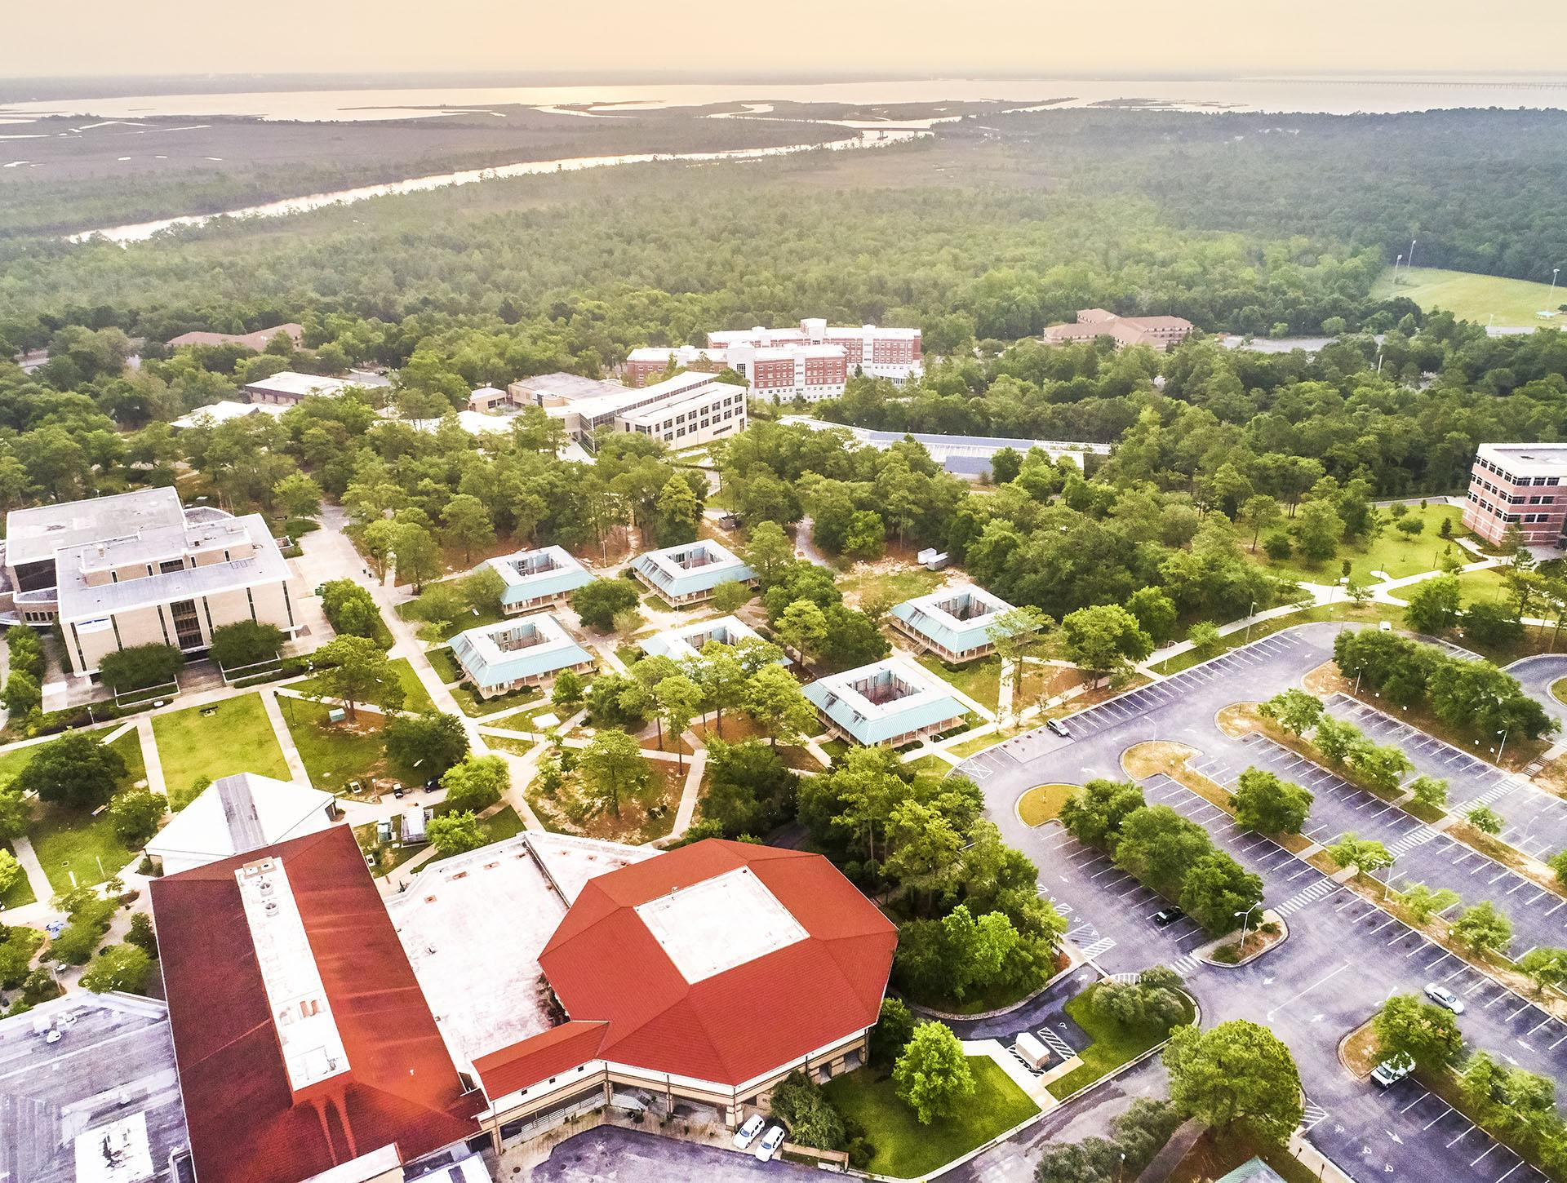
UWF DE Agreements
Escambia County Public Schools
Escambia County Virtual School/Homeschool
Santa Rosa County Public Schools
Santa Rosa County Virtual School/Homeschool
Okaloosa County Public Schools
Holmes County Public Schools
Christian Institute of Arts and Sciences (private)
Trinitas Christian School (private)
Notes:
In order to participate in Dual Enrollment at UWF, your school should have an Articulation Agreement on file. This Agreement determines the specific requirements each school has set for eligibility. UWF Currently has an agreement for the schools listed.

Slide 7
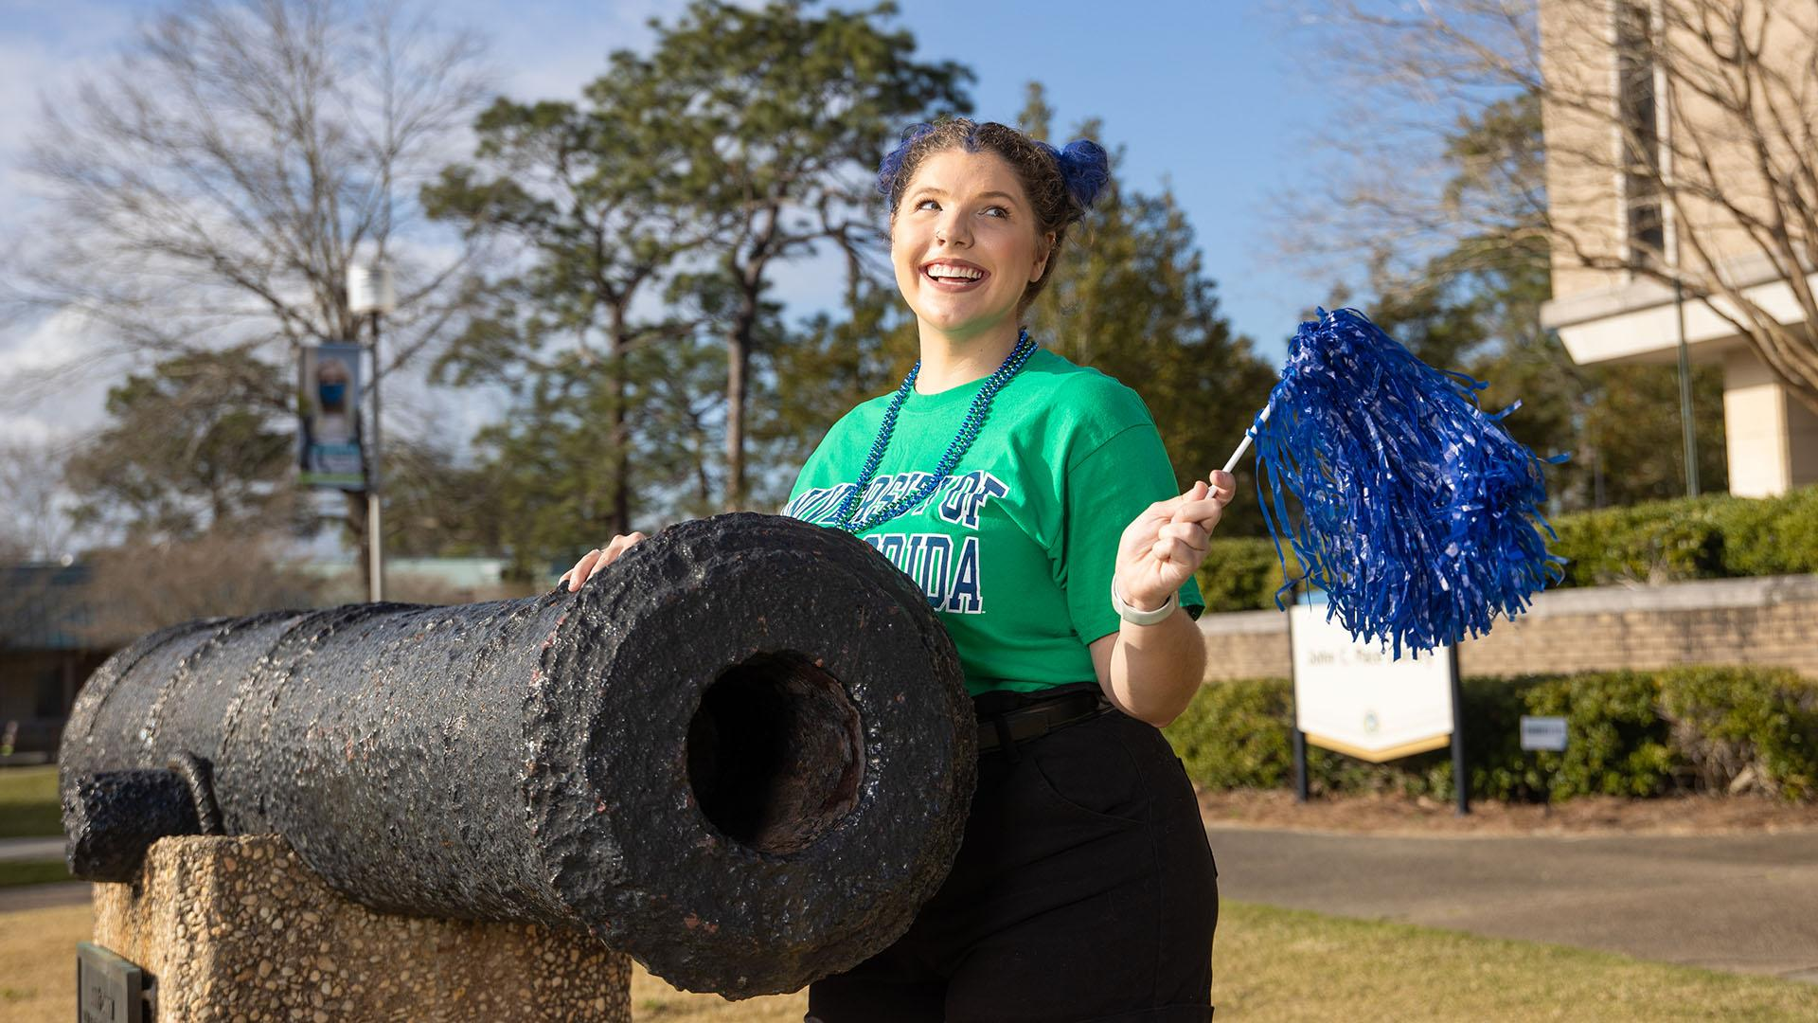
Sounds good! How do I get started?

Slide 8

Dual Enrollment
at UWF
uwf.edu/DE

Slide 9

Step One
Meet with your school guidance counselor to determine your eligibility.
Notes:
Meet with your High School Guidance Counselor to determine your eligibility (next slide).

Slide 10

Eligibility
Minimum of:
Grade level 6-12.
Three high school Core Academic Credits.
Unweighted 3.00 GPA on a 4.00 scale.
To continue in DE: UWF semester GPA of 2.50; no grade below C.
Notes:
Attained grade level of at least 6th – 12th, per state statute: Section 1007.271(2) F.S.
Earned a minimum of 3 high school Core Academic Credits
Posses a minimum, unweighted GPA of 3.00 on a 4.00 scale.
Have taken the SAT, ACR, or PERT exams for courses that require academic placement.
To continue in DE: UWF semester GPA of 2.50; no grade below C.

Slide 11
Eligibility, continued
Must have taken SAT, ACT, or PERT for courses that require academic placement. Minimum scores:
SAT
ACT
PERT
Evidence-Based Reading and Writing: 510
Math: 500
Reading: 19
Math: 20
English: 18
Reading: 106
Math: 115
English: 103
Notes:
Have taken the SAT, ACR, or PERT exams for courses that require academic placement.
SAT minimum scores: Evidence-Based Reading & Writing - 510; Math - 500
ACT minimum scores: Reading - 19; Math - 20; English - 18
PERT minimum Scores: Reading - 106; Mathematics - 115; and English - 103

Slide 12
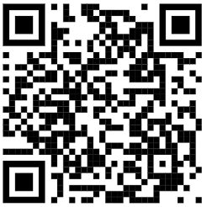

Step Two
Complete and submit the dual enrollment application.
Do not register with your school-assigned email.
uwf.edu/DEApply
Notes:
Any communication concerning the receipt of your application and future registration will be sent to the address listed on the application.
Please do not use the email account assigned to you by your high school, as filters may block emails from UWF.
If there is no break in dual enrollment at UWF for more than two semesters, this application will only have to be completed once.
If a student applies for Dual Enrollment and they have had any issues with misconduct prior to or have had any previous violations of the law resulting in probation, community service, a jail sentence, or the revocation/suspension of your driver’s license, the student will be required to file and complete a review with the Office of Student Rights and Responsibilities for review before being admitted.

Slide 13

Step Three
Complete the dual enrollment approval form each semester and course change.
uwf.edu/DE
Notes:
Consult with your school counselor to identify the course(s) for which you seek registration. We recommend choosing a couple of backup courses, as some courses may not have availability.
This form must be submitted for each semester you seek registration as a dual enrollment student at UWF. An approval form can only be processed when there is an active application.
Your approval form must be signed by your Guidance Counselor as it is your authorization to take a given course.
A new approval form is required for any courses or course schedule changes requested. Ex: CHM 1020 to BSC 1005. If there is a specific course (teacher, time, type preference) you would like to take, please be sure to include the CRN for your preference.
A new approval form is not required for a section change. Ex: BSC 1005 with Dr. Honeycutt to BSC 1005 with Dr. Clifton.

Slide 14

Communications
DualEnrollment@uwf.edu
Notes:
A. PTK - must provide certificate, download on website

Slide 15

Communications
You will be contacted when:
Your application has been processed.
Your approval form has been received and processed.
There are any outstanding issues.
Questions? Email DualEnrollment@uwf.edu
Notes:
All communication with the student regarding Dual Enrollment will be sent to the email address shared within the Dual Enrollment Application. Once the student’s ArgoNet account is activated, all official UWF communications will be sent to their student email address.
At a minimum the student can expect to be contacted:
When their application has been processed.
When their approval form has been received and processed. The student will receive a confirmation of their registration.
When there are any outstanding issues including remaining holds, schedule conflicts, missing approval form, etc.
Any questions or direct communication regarding Dual Enrollment can be sent to DualEnrollment@uwf.edu.

Slide 16

Communications
Communication will be sent to the email address used on your
DE application.
If you are admitted and activate you UWF student ArgoNet account, all official UWF communications will start going to your UWF student email.
Notes:
Communication will be sent to the email address used on your DE application.
If you are admitted and activate you UWF student ArgoNet account, all official UWF communications will start going to your UWF student email.

Slide 17

After Admission
uwf.edu/DE

Slide 18

Account Activation
If you are admitted,
you will need to follow provided instructions
to upgrade your UWF student ArgoNet account. This will activate you UWF student email.
Notes:
If you are admitted, you will need to follow provided instructions to upgrade your UWF student ArgoNet account. This will activate you UWF student email.

Slide 19

Two Holds to Expect
A “hold” prevents class registration until you address it.
If you are admitted to DE, you will see two holds after you activate your UWF student account:
Financial Responsibility Hold
Immunization Hold

Slide 20

Financial Responsibility Hold
Dual enrollment students do not pay tuition and associated fees.
However, this hold appears to ALL students taking classes at UWF each semester. This hold requires the student to acknowledge financial responsibility for their registered courses.
Notes:
Dual enrollment students do not pay tuition and associated fees.
However, this hold appears to ALL students taking classes at UWF each semester. This hold requires the student to acknowledge financial responsibility for their registered courses.

Slide 21
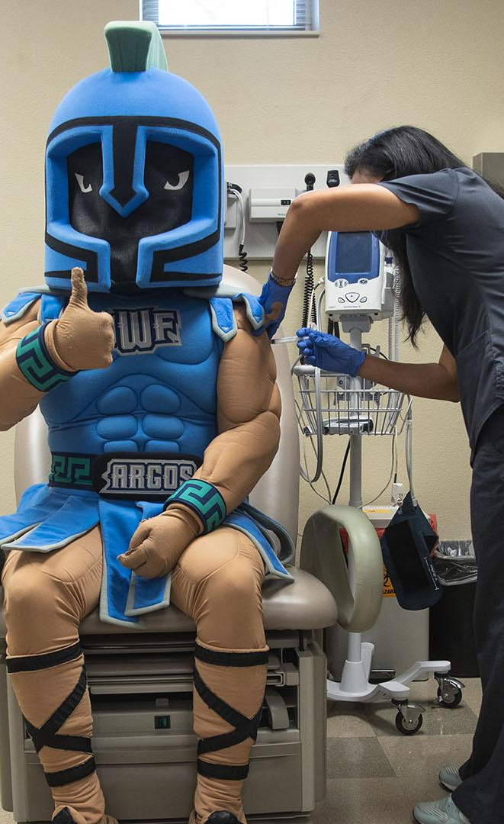
Immunization Hold
You will only have to address this hold once as a dual enrollment student.
To comply with state laws and regulations, UWF requires the submission of shot records to address immunization and related concerns.
Notes:
You will only have to address this hold once as a dual enrollment student.
To comply with state laws and regulations, UWF requires the submission of shot records to address immunization and related concerns.

Slide 22
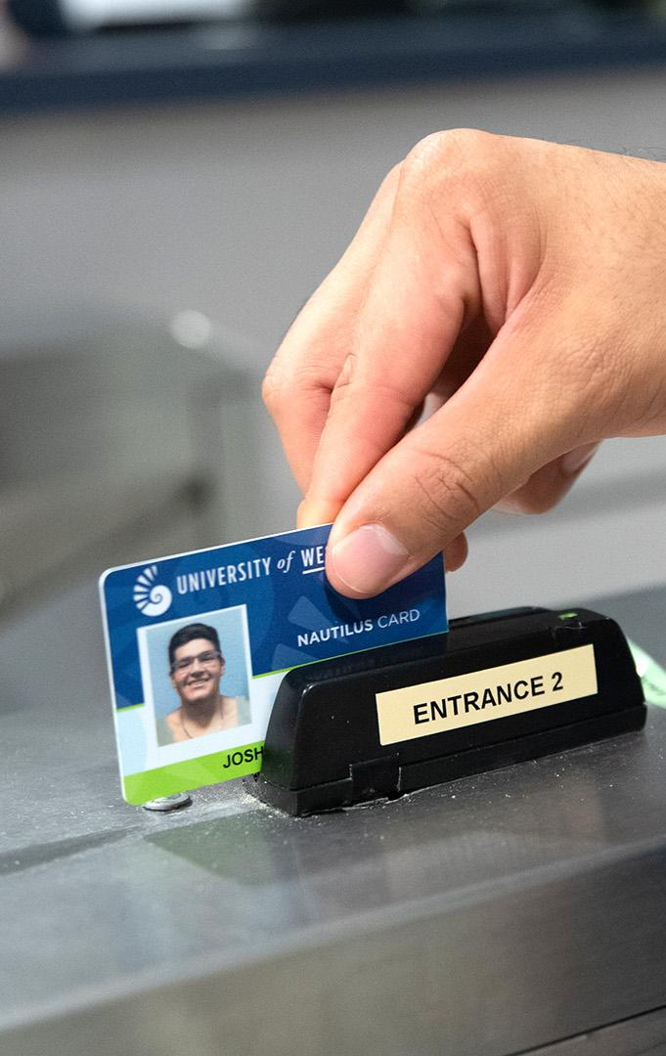
Nautilus Card
You will be required to purchase a Nautilus Card student ID ($10 annually) before classes begin.
uwf.edu/IDCard
Notes:
You will be required to purchase a Nautilus Card student ID ($10 annually) before classes begin.

Slide 23

Registering for Classes
uwf.edu/DE

Slide 24

Registration
DE students must register for classes using the DE approval form only.
uwf.edu/DE
Notes:
Dual Enrollment students at UWF do not self register for classes. Instead, the Dual Enrollment Program Manager uses the approval form to complete the student’s registration. If a student self registers, the course will not be codes for Dual Enrollment appropriately, which could lead to the student owing for the course.

Slide 25

Guidelines
Maximum course load:
  15 credits Fall/Spring
  6 credits Summer
Follow the same timeline of registration as other students.
Schedule changes can be made through Drop/Add Week.
uwf.edu/AcademicCalendar
Notes:
A student can register for a maximum of 15 credits for the Fall and Spring semester and up to 6 credits for Summer semester.
Dual Enrollment students are held to the same timeline of registration.
Schedule changes can be made through the week of drop/add.

Slide 26
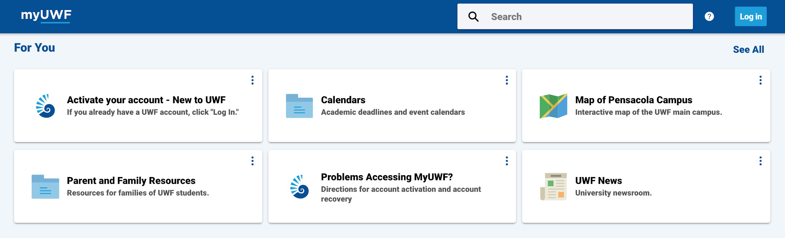
MyUWF
my.uwf.edu
MyUWF is an online portal for admitted student resources, including:
My Classes: Your schedule and books.
Syllabus Viewer: Review content for courses that interest you.
Student Academic Records Menu: Grades, holds, etc. Grades will be sent to your school counselor at the end of each semester.
Course Search: Search for courses by semester.
Notes:
MyUWF is an online portal for admitted student resources, including:
Course Search: Search for courses by semester.
My Classes: Your schedule and books.
Syllabus Viewer: Review content for courses that interest you.
Student Academic Records Menu: Grades, holds, etc. Grades will be sent to your school counselor at the end of each semester.

Slide 27
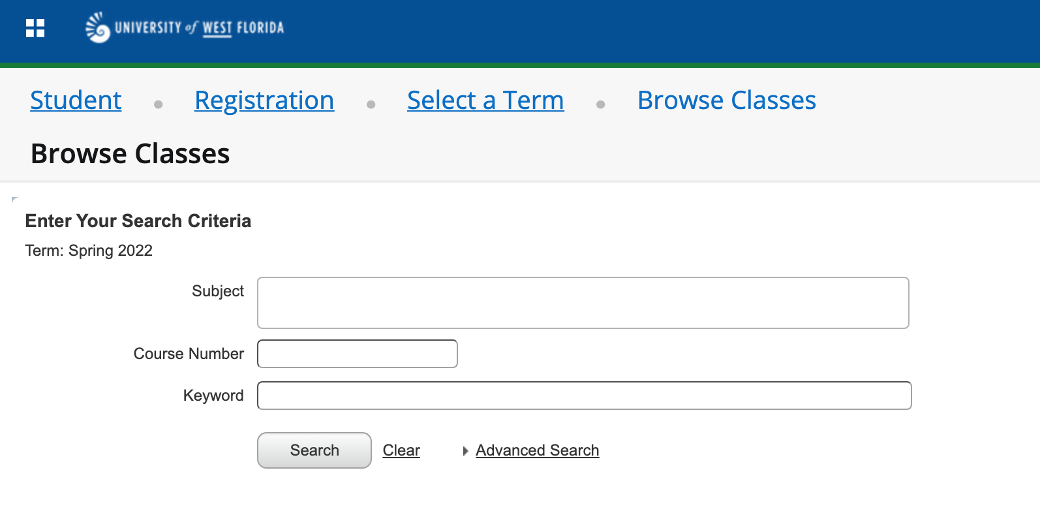
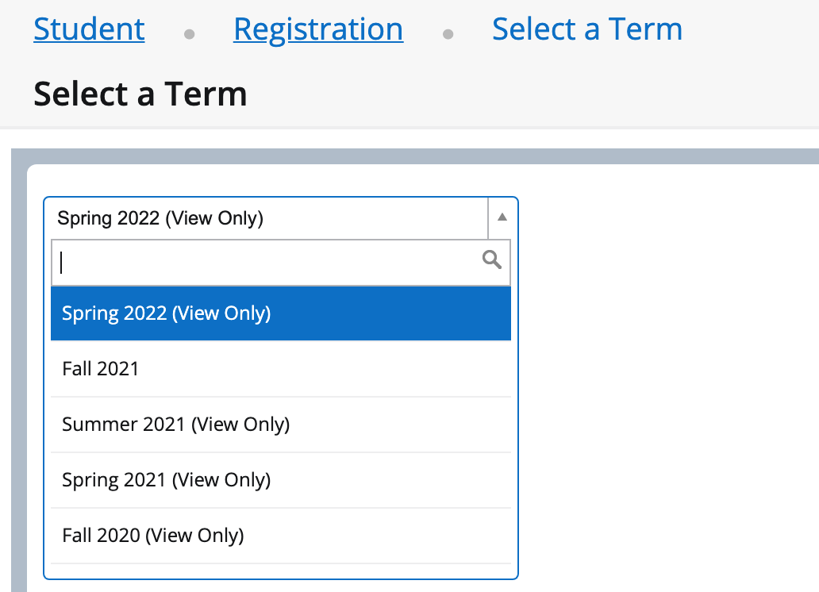
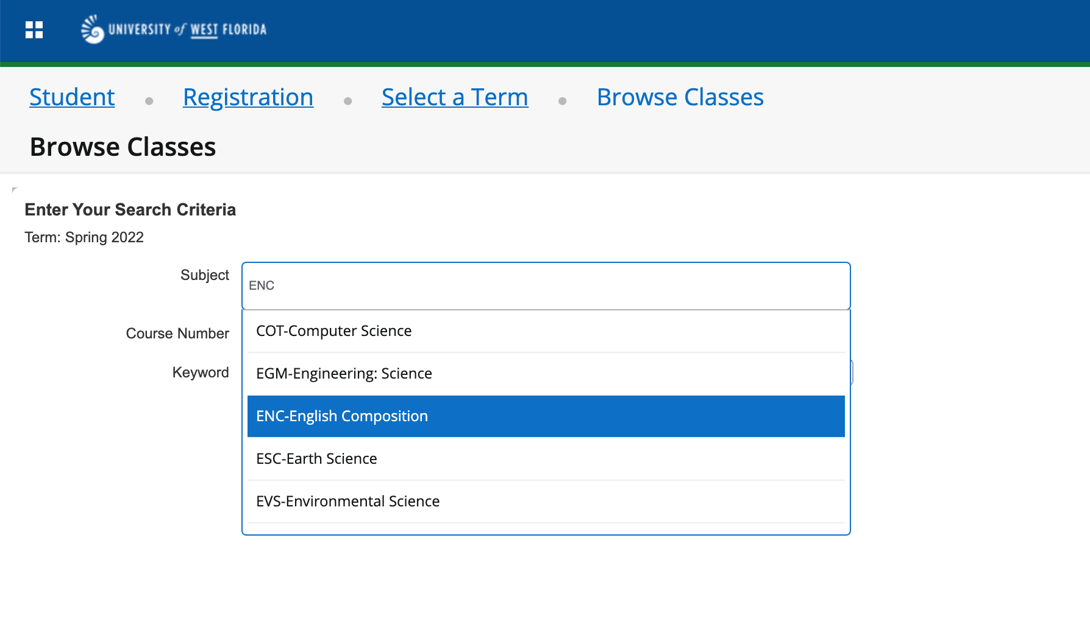
Course Search
uwf.edu/CourseSearch
Notes:
A student can search for classes through the Course Search.
Select the Semester you would like to search, then select continue.
From here, select a specific subject, course number, or do an Advanced Search to identify a selection.

Slide 28
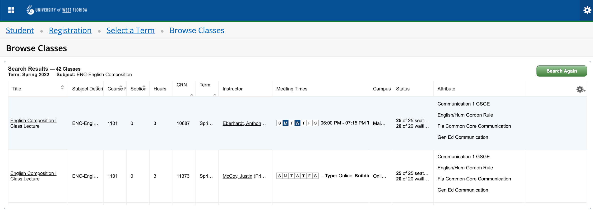
Course Search Results
uwf.edu/CourseSearch
Notes:
The queue should then populate based on your search.

Slide 29

After Registration
Share your DE schedule with your school counselor. They need this for their records and your books.
Notes:
Share your DE schedule with your school counselor. They need this for their records and your books.

Slide 30

Thank You

Slide 31
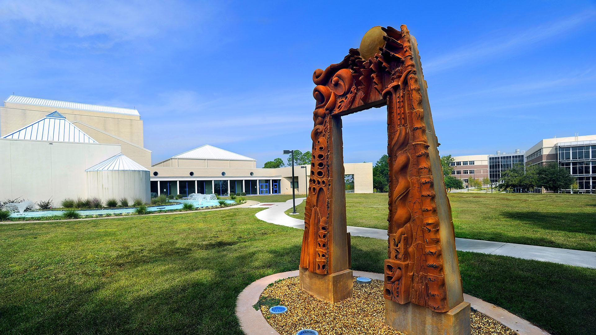
Q&A

